Slide 1

ParkScope
WazePark Assist
​
By Lior Yanwo
​

Slide 2
Motivating Use Case
Urban congestion caused by drivers searching for parking.
No navigation system predicts parking difficulty near the destination.
Saves time and reduces unnecessary loops around the area.
Improves navigation accuracy with smarter routing decisions.
Enhances user experience by suggesting nearby parking lots when needed.
Parking availability changes dynamically – difficult for humans to estimate.
PARKING LOT AVAILABLE 200m

Slide 3
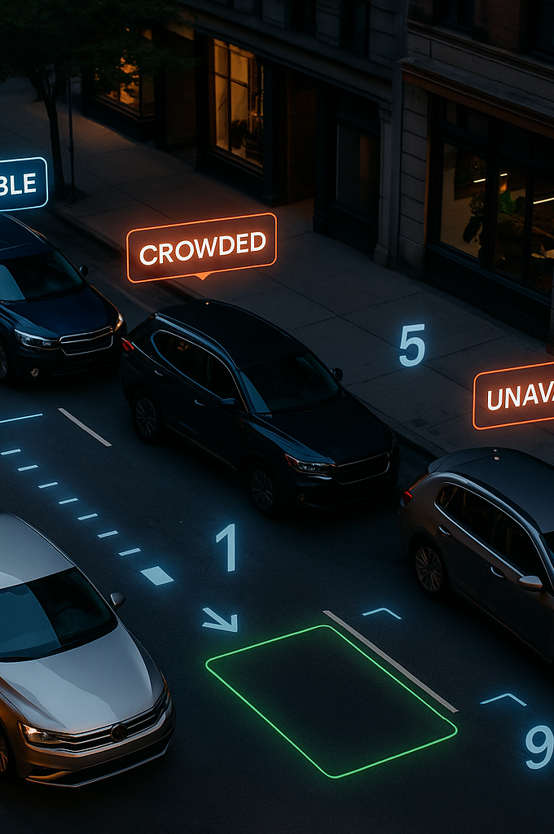
Project Task Description
Problem Type:
Input:
Output:
A single street photo showing parked cars and curb areas, allowing analysis of parking density.
A numeric score indicating how hard it is to find parking : 1 = easy, 10 = very difficult.
Computer Vision – Detection + Regression
Novelty:
Use Case:
No existing labeled dataset for parking difficulty; requires synthetic + auto-generated labels
Integration as a Waze/Maps feature for smart parking rerouting

Slide 4

Models & Methods
Baseline Model – XGBoost Regressor
Used on numerical features extracted from the image (number of parked cars, curb length, density ratio). Provides a fast and stable baseline for difficulty prediction.
Deep Learning Model – ResNet50 (Regression Head)
A fine-tuned convolutional neural network that receives the full street image and learns visual patterns related to parking difficulty (street width, spacing, shadows, crowding). Suitable for medium-size datasets.
Advanced Model – Vision Transformer (ViT)
A state-of-the-art vision model that processes the entire image using attention mechanisms. Captures complex relationships in the scene and often outperforms CNNs in image-based regression tasks. Used as the final comparison model for best performance.

Slide 5
Data Specification
Data Sources:
Public street-image datasets (Cityscapes, BDD100K).
Synthetic images generated with GenAI (various street types and densities).
Augmented variations (crop, lighting, weather, blur, resolution).
Data Types:
Raw street images with visible parked vehicles.
Detection outputs (YOLO/DETR bounding boxes).
Automatically generated density-based difficulty scores (1–10).
Numerical features for XGBoost (car count, curb length, density ratio).
Full images for ResNet & ViT regression models.
Data Size:
Initial sample-size dataset for baseline training.
Larger synthetic set for deep model fine-tuning.

Slide 6
Metrics & KPIs
Metrics:
MAE
RMSE
Pearson Correlation
Measures accuracy of the predicted parking difficulty score.
Highlights larger prediction errors.
Measures alignment between model predictions and true density values
Difficulty Category Accuracy
(easy / medium / hard)
Evaluation Scope:
Compare XGBoost vs ResNet vs ViT.
Ablation: image-only vs feature-only models.
Real vs synthetic image performance.
Services / Future Use:
Potential Waze integration for smart rerouting.
Suggest nearest parking lot when predicted difficulty is high.

Slide 7

THANK U GOODBYE

